Slide 1
Prediction Policy
Susan Athey-Machine Learning and Causal Inference
Thanks to Sendhil Mullainathan for sharing his slides

Slide 2
Three Direct Uses of Prediction
Policy
Testing Whether Theories are Right
Testing Theory Completeness

Slide 3
When is Prediction Primary Focus?
Economics: “allocation of scarce resources”
An allocation is a decision.
Generally, optimizing decisions requires knowing the counterfactual payoffs from alternative decisions.
Hence: intense focus on causal inference in applied economics
Examples where prediction plays the dominant role in a decision
Decision is obvious given an unknown state
Many decisions hinge on a prediction of a future state
For more discussion, see:
Glaeser, Kominers, Luca, and Naik (2018) and other papers by this team

Slide 4
Prediction and Decision-Making: Predicting a State Variable
Kleinberg, Ludwig, Mullainathan, and Obermeyer (2015)
Motivating examples:
Will it rain? (Should I take an umbrella?)
Which teacher is best? (Hiring, promotion)
Unemployment spell length? (Savings)
Risk of violation of regulation (Health inspections)
Riskiest youth (Targeting interventions)
Creditworthiness (Granting loans)
Empirical applications:
Will defendant show up for court? (Should we grant bail?)
Will patient die within the year? (Should we replace joints?)

Slide 5
Allocation of Inspections
Examples:
Auditors
Health inspectors
Fire code inspectors
Equipment
Efficient use of resources:
Inspect highest-risk units
(Assuming you can remedy problem at equal cost for all…)

Slide 6
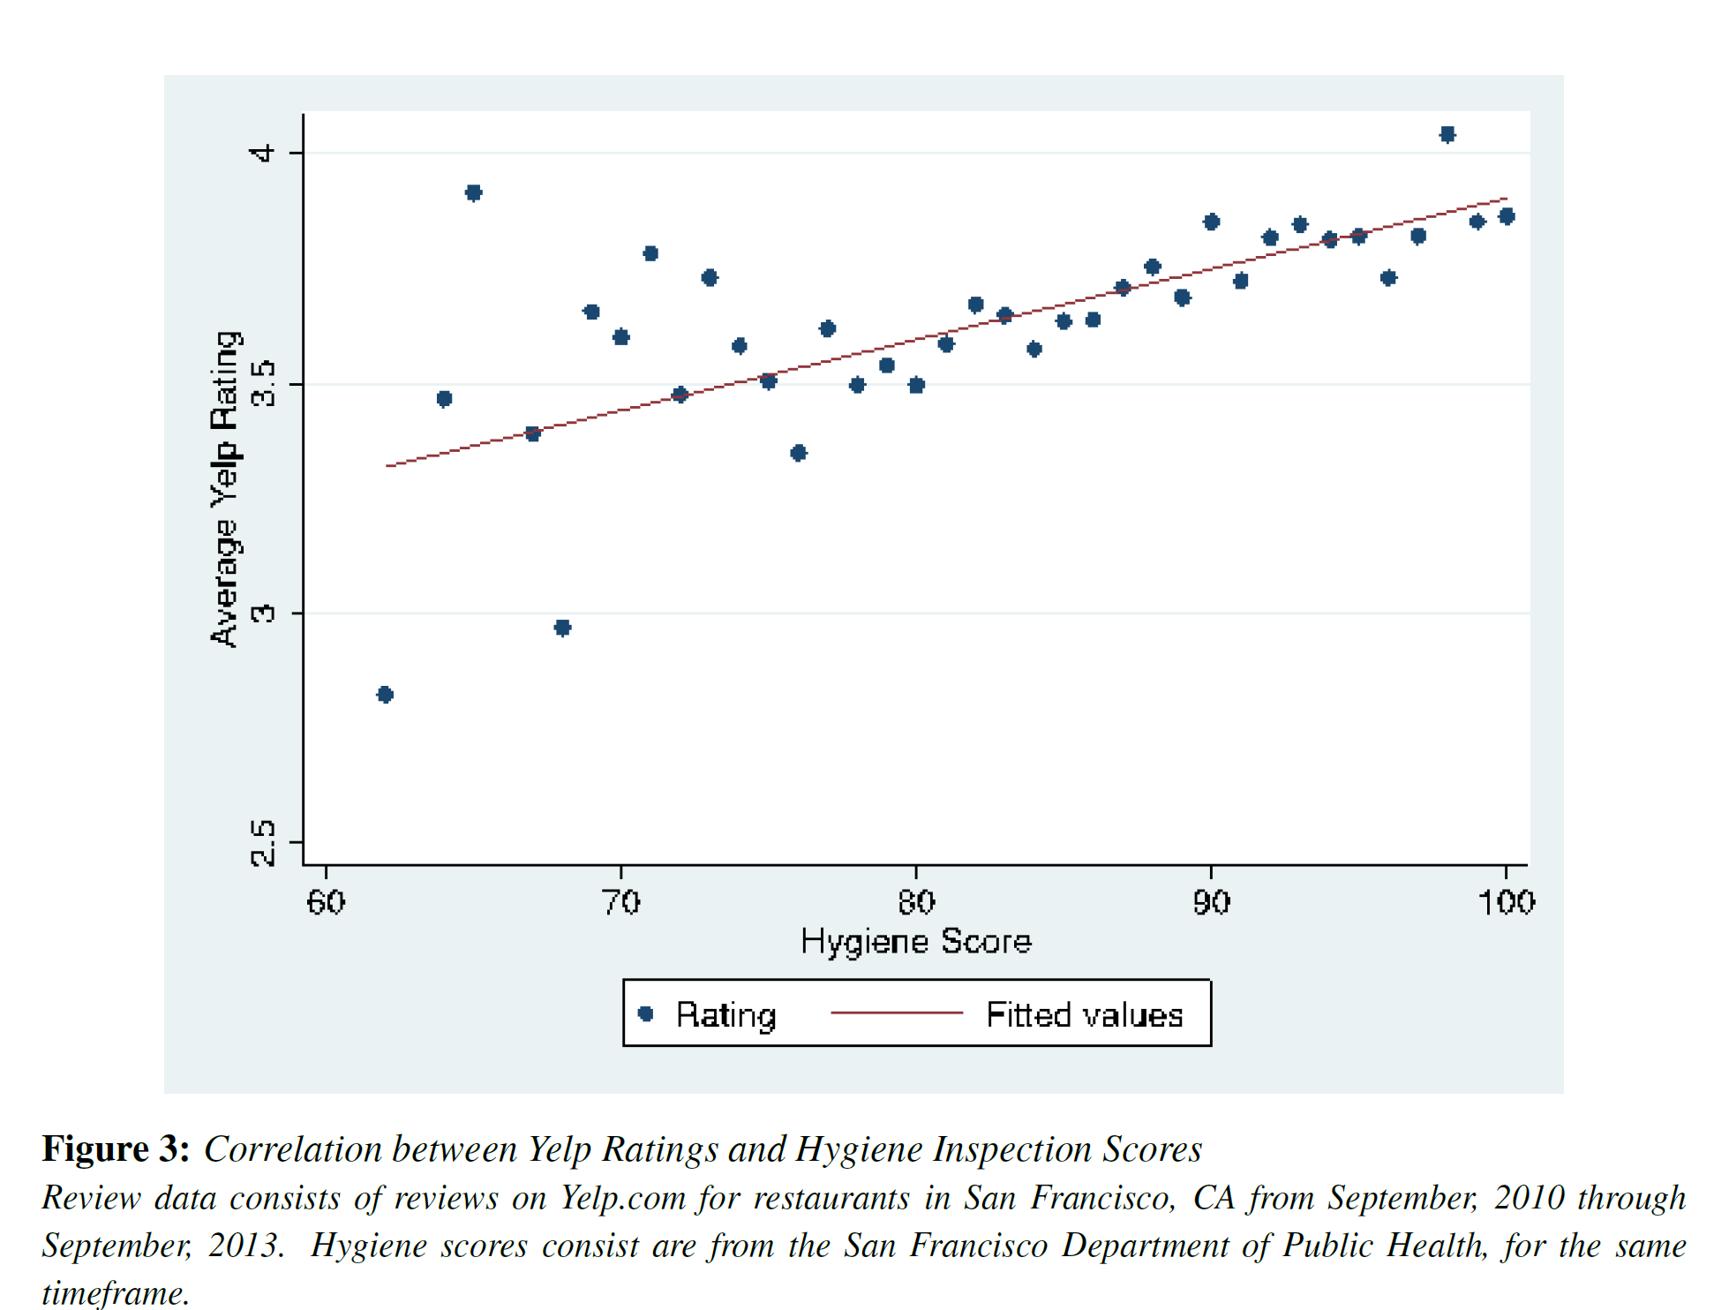

Slide 7
Prediction Problem
Over 750,000 joint replacements every year
Benefits
Improved mobility and reduced pain
Costs
Monetary: $15,000 (roughly)
Non-monetary: short-run utility costs as people recover from surgery

Slide 8
Look at death rate in a year
How well are we doing avoiding unnecessary surgery?
Medicare claims data 2010 surgeries for joint replacement
Average death rate is 5%
But is that the right metric for excess joint replacements?
Don’t want average patient
Want marginal patient
Predictably highest risk patients

Slide 9
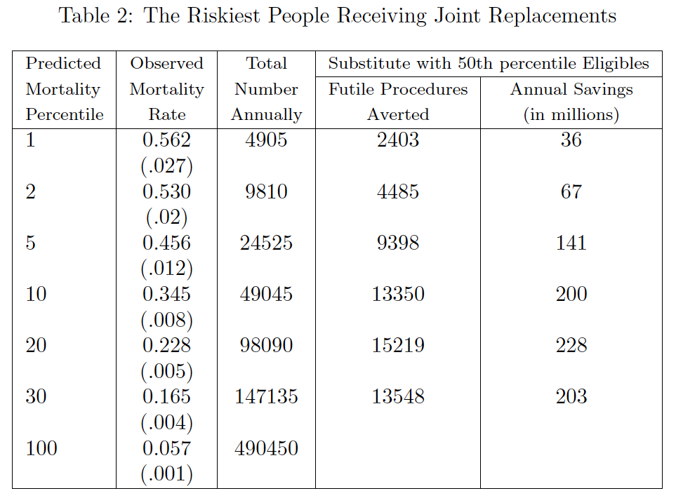
Approach: use ML methods to predict mortality as a function of covariates
e.g. regularized regression, random forest
Put individuals into percentiles of mortality risk
A large number of joint replacements going to people who die within the year
Could we just eliminate the ones above a certain risk?

Slide 10
Econometrics of Prediction Policy Problems
Problem: Omitted Payoff Bias

Slide 11
This Unobservable is a Problem
What if those with high
Mortality also benefit most?
Pain

Slide 12
Omitted Payoff Bias

Slide 13
Econometrics of Prediction Policy Problems
Omitted Payoff Bias
Like omitted variable bias but not in y
Can partially assess on the basis of observables

Slide 14
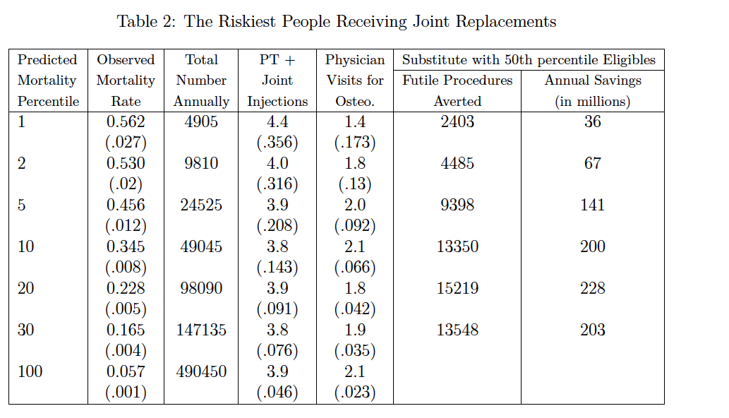
No sign of bias:
Highest risk show no signs of greater benefit

Slide 15
Quantifying gain of predicting better
Allocation problem:
Reallocate joints to other eligible patients
How to estimate the risk of those who didn’t get surgery?
Look at those who could get surgery but didn’t
Doctors should choose the least risky first
So those who don’t receive should be particularly risky.
Take a conservative approach
Compare to median risk in this pool

Slide 17
Assessing the Research Agenda
Follows economic tradition of using data to improve policy
In an area of economic interest
Similar to a lot of health econ work
Of course this does not answer all questions of interest
Why not?

Slide 18
Another Prediction Policy Problem
Each year police make over 12 million arrests
Many detained in jail before trial
Release vs. detain high stakes
Pre-trial detention spells avg. 2-3 months (can be up to 9-12 months)
Nearly 750,000 people in jails in US
Consequential for jobs, families as well as crime
Kleinberg Lakkaraju Leskovec Ludwig and Mullainathan

Slide 19
Judge’s Problem
Judge must decide whether to release or not (bail)
Defendant when out on bail can behave badly:
Fail to appear at case
Commit a crime
The judge is making a prediction

Slide 20
PREDICTION

Slide 21
Omitted Payoff Bias?
Bail carefully chosen
Unlike other sentencing no other concerns:
Retributive justice
Family & other considerations low
Bad use case: Parole Decision

Slide 22
Evaluating the Prediction
NOT just AUC or Loss
Use predictions to create a release rule
What is the release – crime rate tradeoff?
Note: There’s a problem

Slide 23
Econometrics of Prediction Policy Problems
Omitted Payoff Bias
“Selective Labels”
What do we do with people algorithm releases that judge jails?
(Like people who get surgery and didn’t before)

Slide 25
Selective Labels Revisted
What is the crime rate we must use?
For released defendants, empirical crime rate
For jailed ones, imputed crime rate
But imputation may be biased…
Judge sees factors we don’t
Suppose young people have dots on their foreheads
Perfectly predictive: judge releases only if no dot
In released sample: young people have no crime
We would falsely conclude young people have no risk.
But this is because the young people with dots are in jail.
We would then falsely presume when we release all young people we will do better than judge
Key problem: unobserved factors seen by judge affect crime rate (& judge uses these wisely)
How to fix?

Slide 26
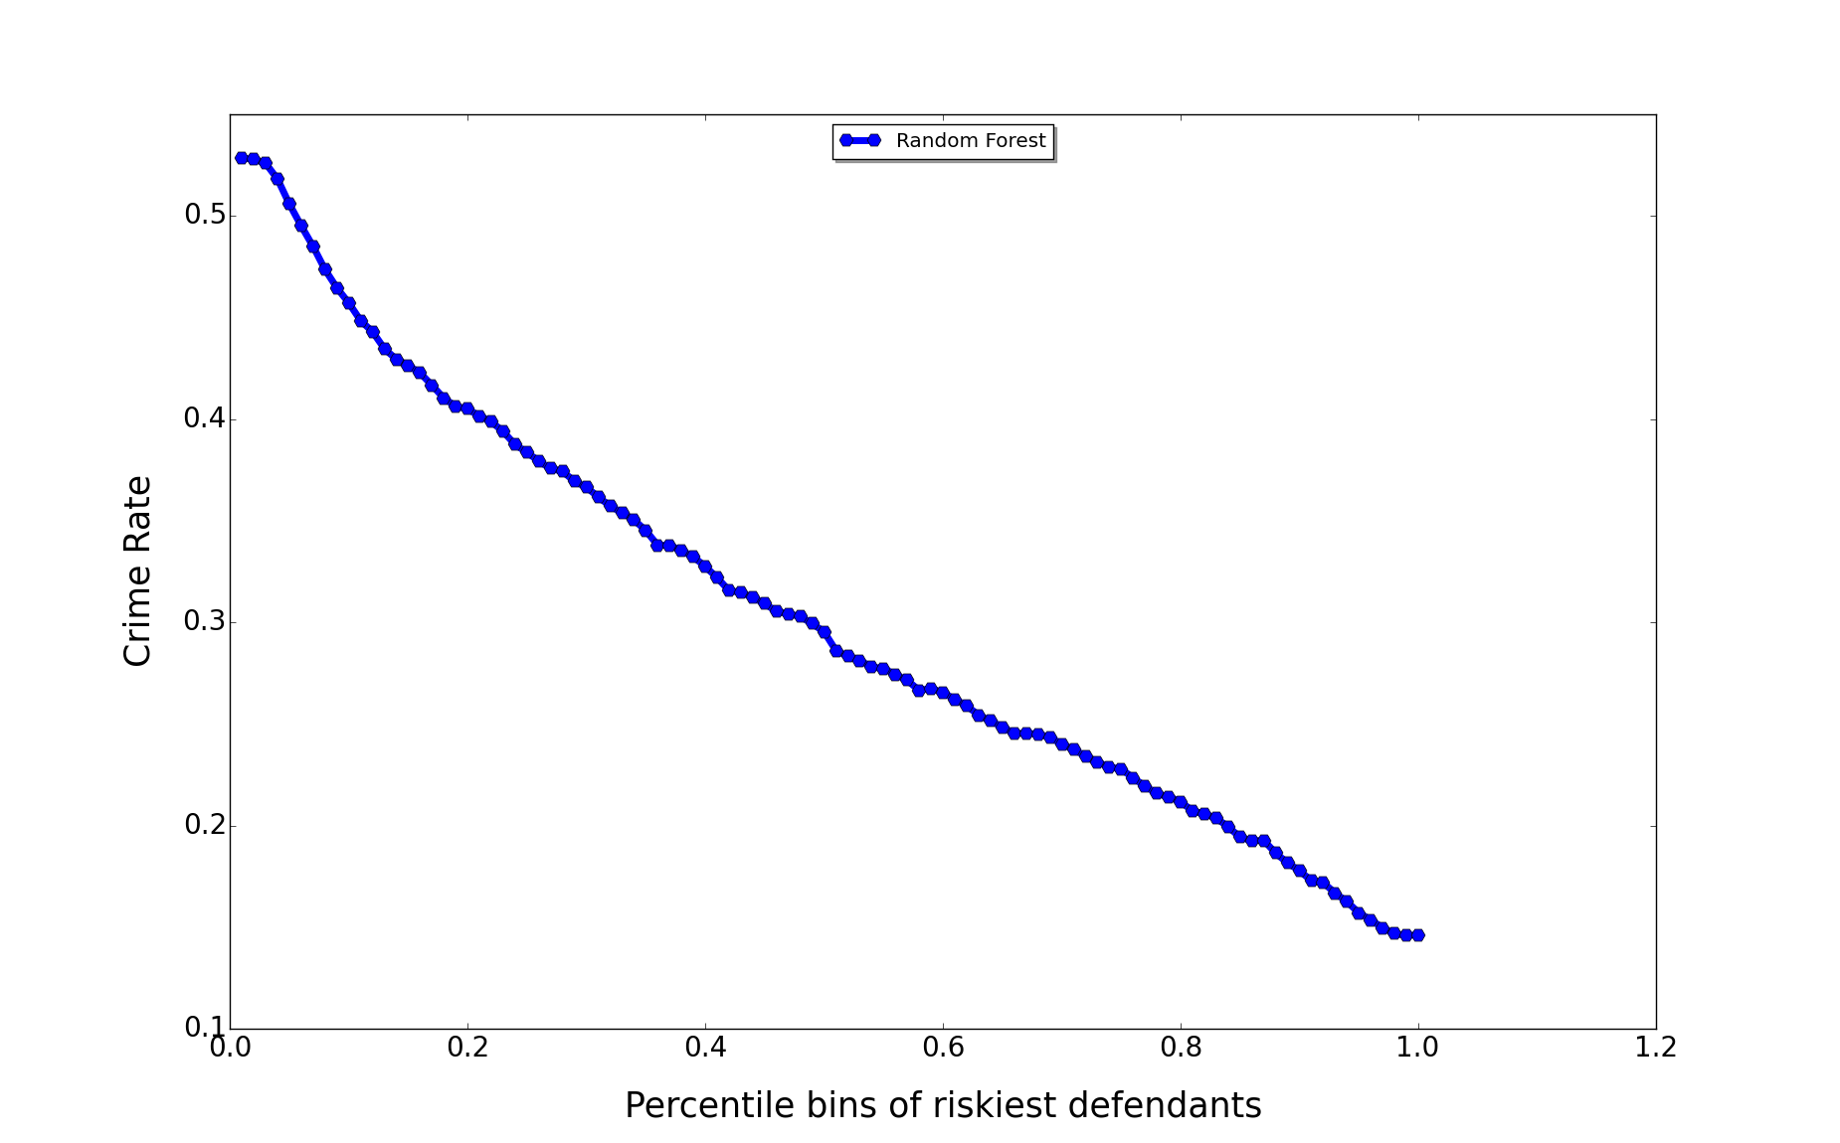
Is not problem when we look just at released
Key insight: Contraction
55%
Would judges knowingly release at 55% risk?
Willing to live with very high crime rates?
Or
Judges mispredicting

Slide 27
Contraction
Multiple judges with similar caseloads and different lenience
Strategy: use most lenient judges.
Take their released population and ask which of those would you incarcerate to become less lenient
Compare to less lenient judges

Slide 30
Contraction
Requires
Judges have similar cases (random assignment)
Does not require judges having “similar” rankings
But does give performance of a different rule
“Human constrained” release rule

Slide 31
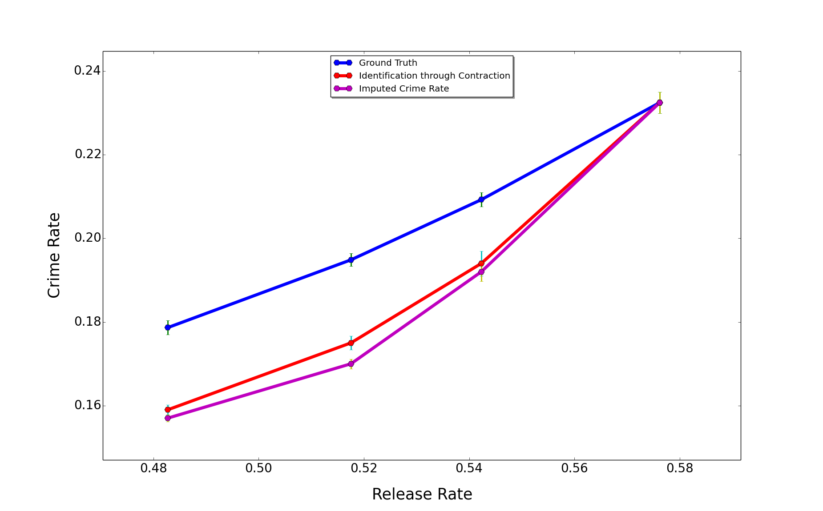
Contraction and Imputation Compared

Slide 32
Selective Labels
In this case does not appear to be a problem
But generically a problem
Extremely common problem – occurs whenever prediction -> decision -> treatment
Data generated by previous decisions

Slide 36
Econometrics of Prediction Policy Problems
Omitted Payoff Bias
Selective Labels
Restricted Inputs

Slide 37
Restricted Inputs
Race and gender are not legal to use
We do not use them
But is that enough?
Reconstruction problem
Optimizing in presence of this additional reconstruction constraint
Rethinking disparate impact and disparate treatment

Slide 38
Racist Algorithms?

Slide 39
Econometrics of Prediction Policy Problems
Omitted Payoff Bias
Selective Labels
Restricted Inputs
Response to Decision Rule

Slide 40
Comparing Judges to Themselves

Slide 41
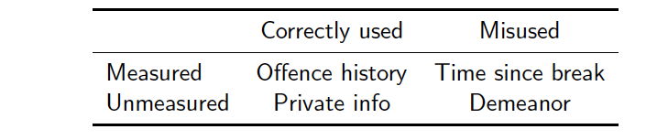
Why do we beat judges?
Judges see more than we do
Perhaps that is the problem
Suggests behavioral economics of salience important here
In general, any kind of “noise”

Slide 42
General points here
Need more ways of comparing human and machine predictions
Notion of private information called into question

Slide 43
Summary
Many prediction policy problems
Raise their own econometric challenges
Can also provide conceptual insights

